Slide 1
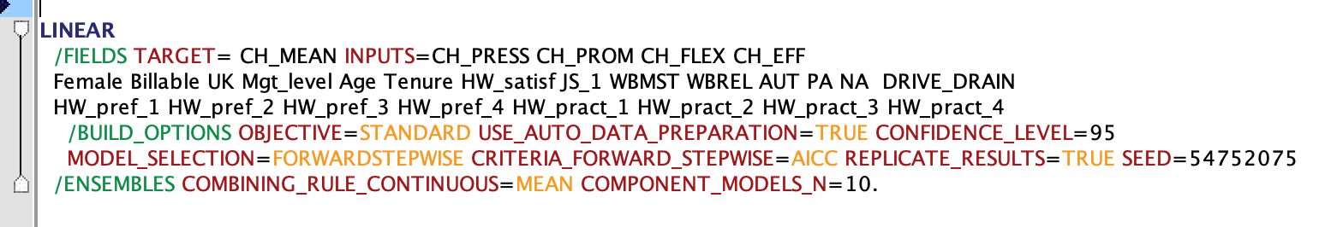
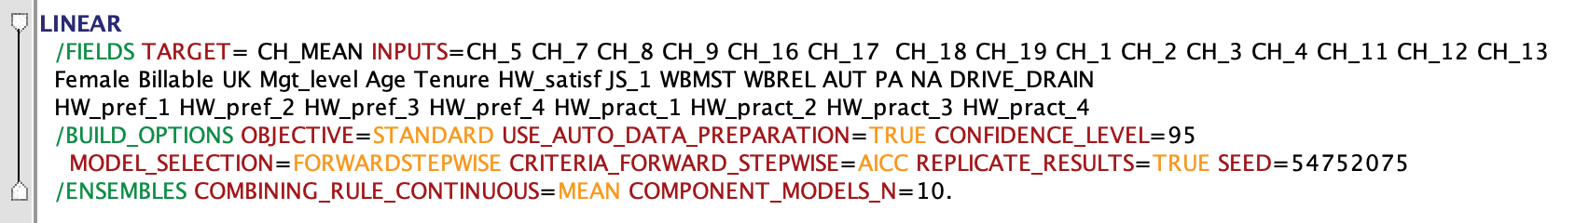
Models
MODEL 1
MODEL 2

Slide 2
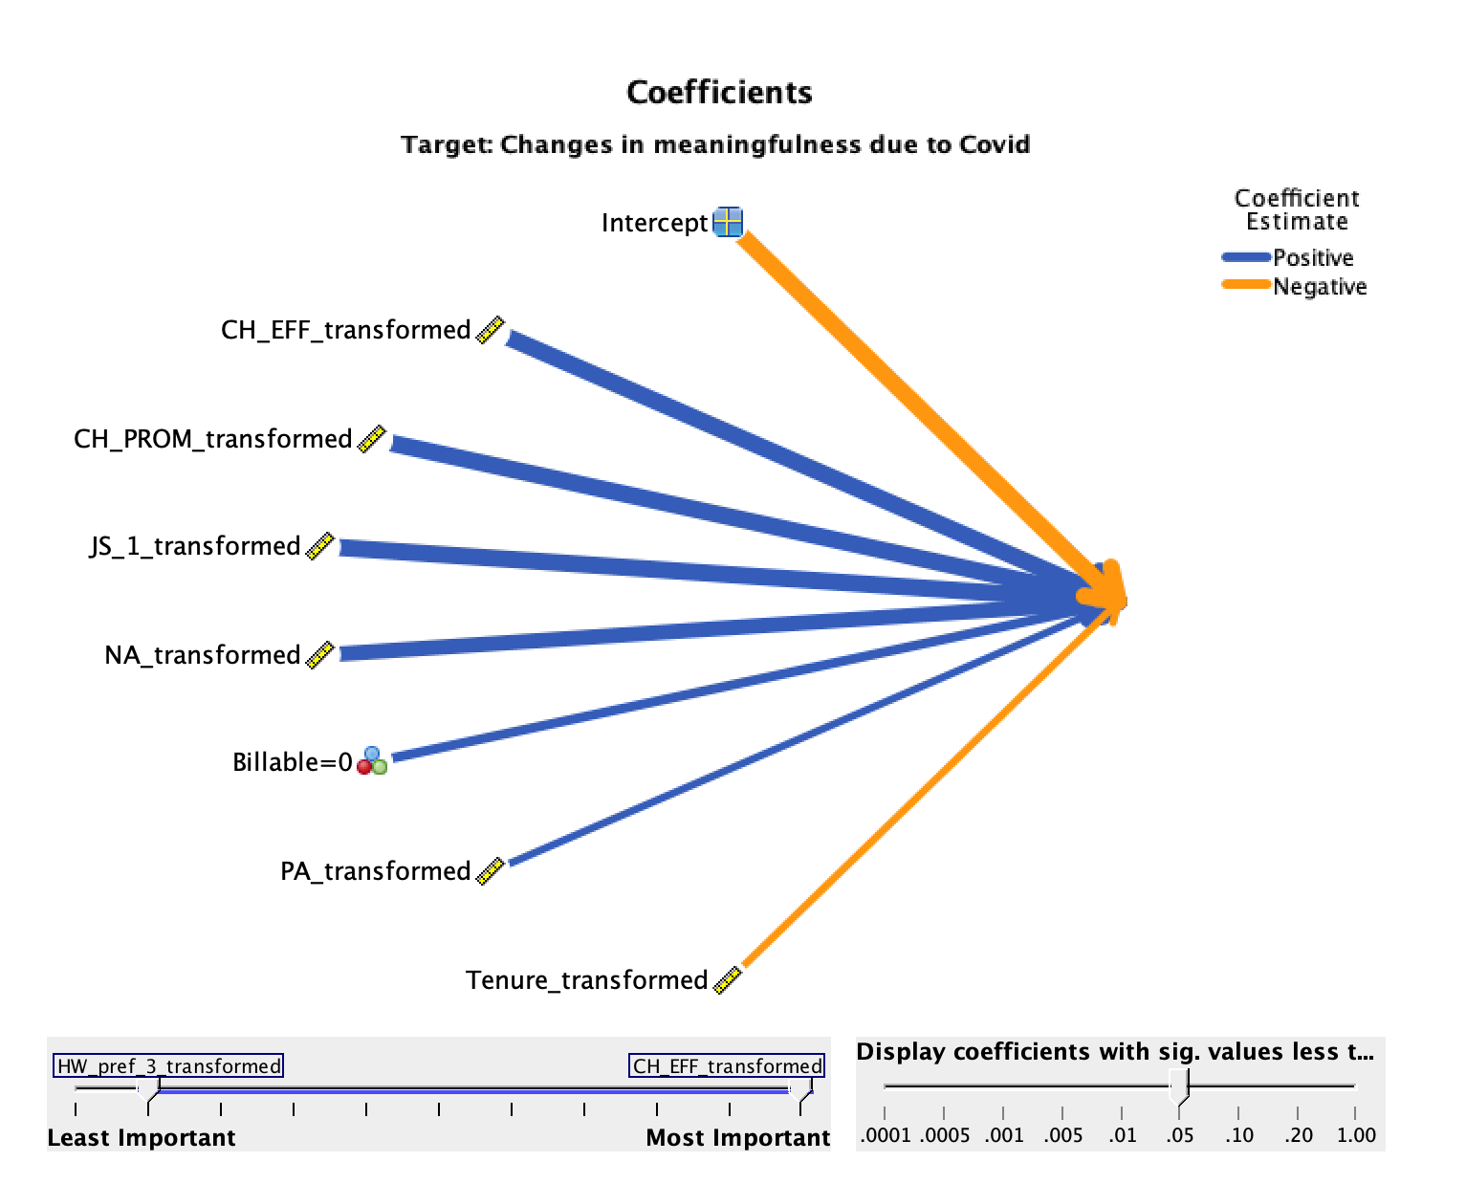
Overall – M1

Slide 3
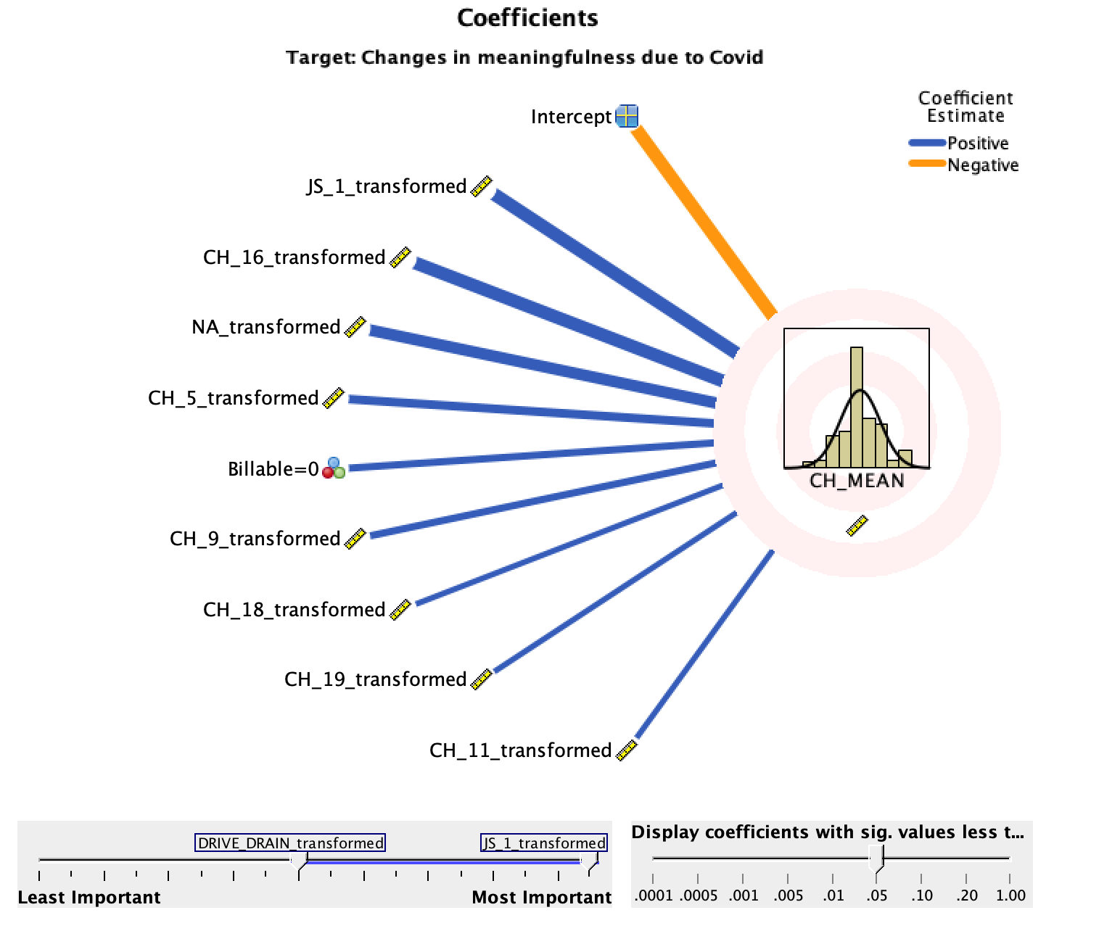
Overall - M2
Feeling connected to others at work (EFF)
Quality of your performance (EFF)
Ability to serve clients (EFF)
Meets expectations (PROM)
Fulfilled promises by the company (PROM)
Autonomy at work (PROM)

Slide 4
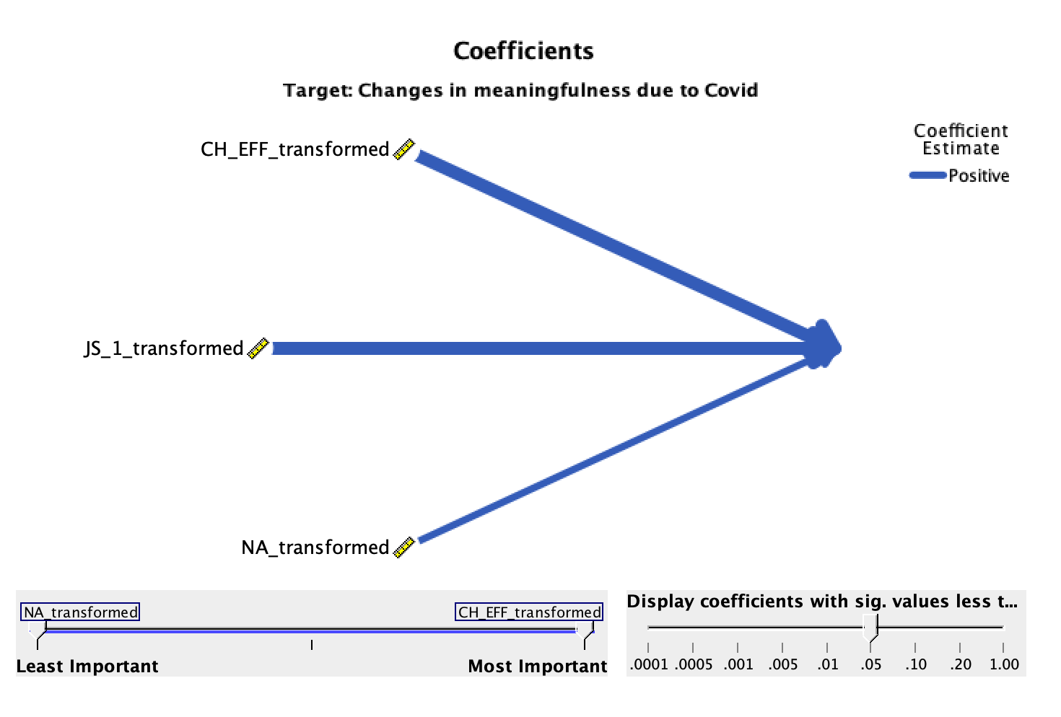
F&E cons - M1

Slide 5
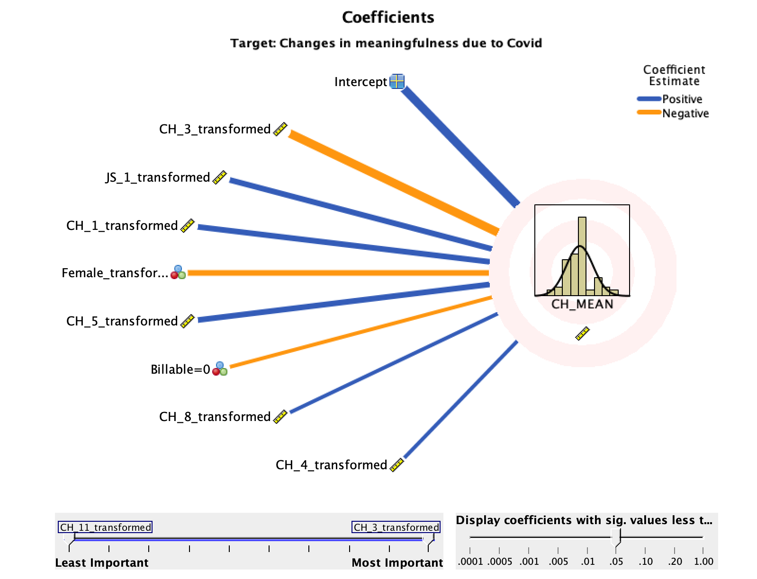
F&E cons - M2
Workload (PRESS)
Work-life balance (PRESS)
Quality of performance (EFF)
Distractions at work (EFF)
Pressure to be available (PRESS)
Notes:
N = 76 (6 excluded in ALR)
Notes:
The main change effects for F&E do not appear in the regression for the overall company EXCEPT FOR CH_5 “quality of performance”
But for both groups meaningfulness seems to be driven by effectiveness variables
While Overall group is more affected by PROMISE variables,
F&E also affected by PRESSURE variables which don’t show up in the Overall group
Job satisfaction plays a role for both Overall and F&E alone
Female and billable indicators are confusing, see next slide for interpretation
Female positively relation
Billable positive relation
No evidence of positive or negative mood here
No evidence of tenure or age effects in either group
Main effects seem to be driven by PRESSURE change effects:
Work-life balance (positive relation)
Pressure to be available (positive relation)
Workload (negative relation)
Also effects of effectiveness
Quality of performance (positive relation)
Distractions at work (positive relation)

Slide 6
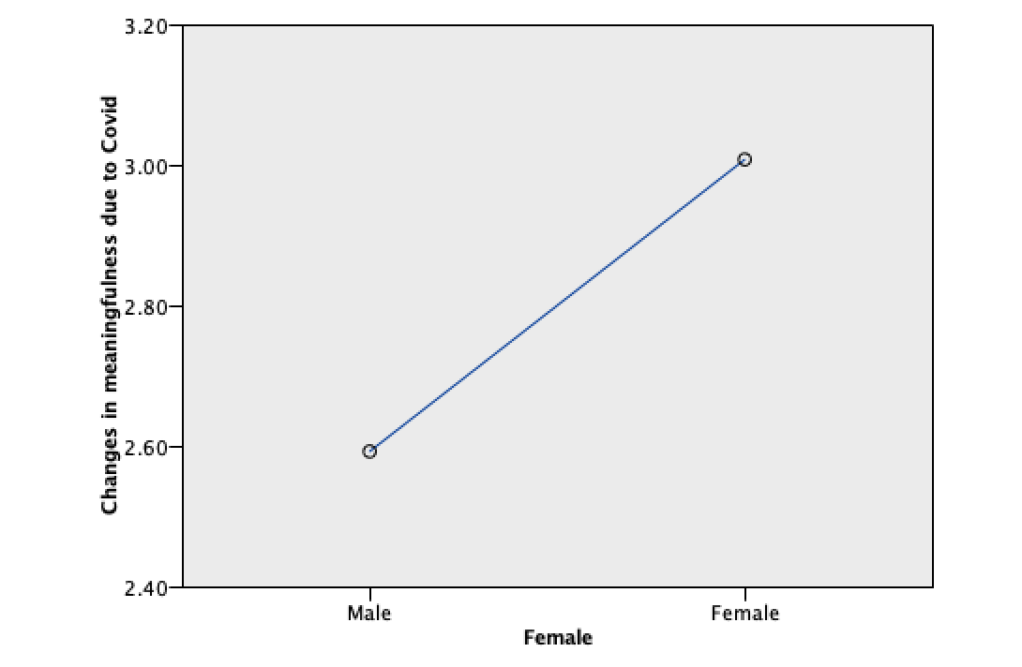
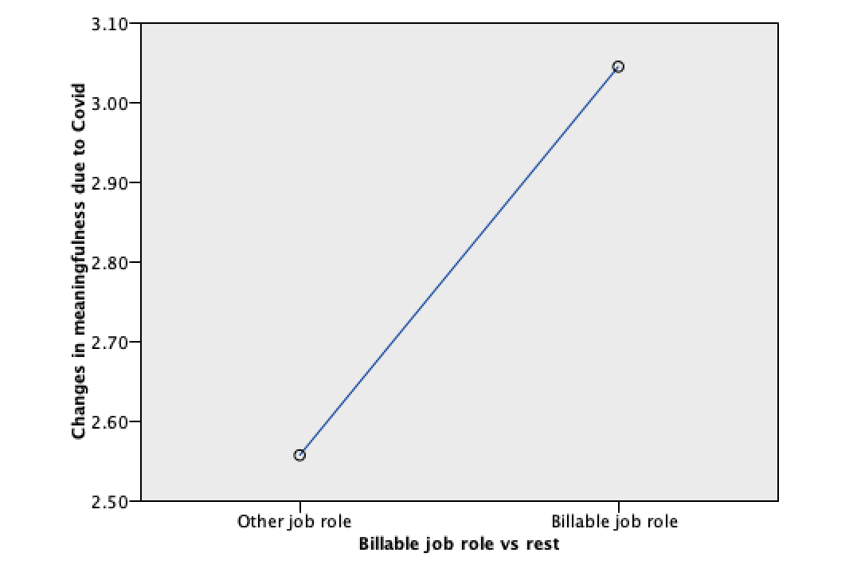
Indicators: female and billable

Slide 7
Interactions?

Slide 8
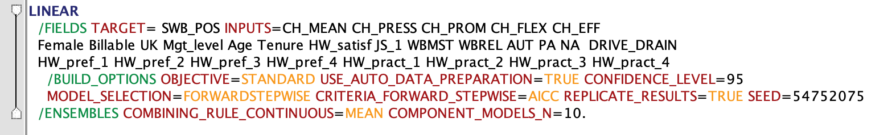
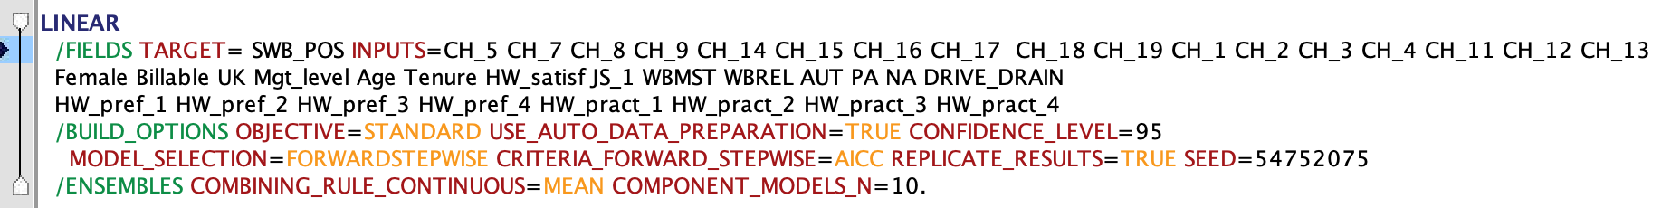
Models – Positive wellbeing
MODEL 1
MODEL 2

Slide 9
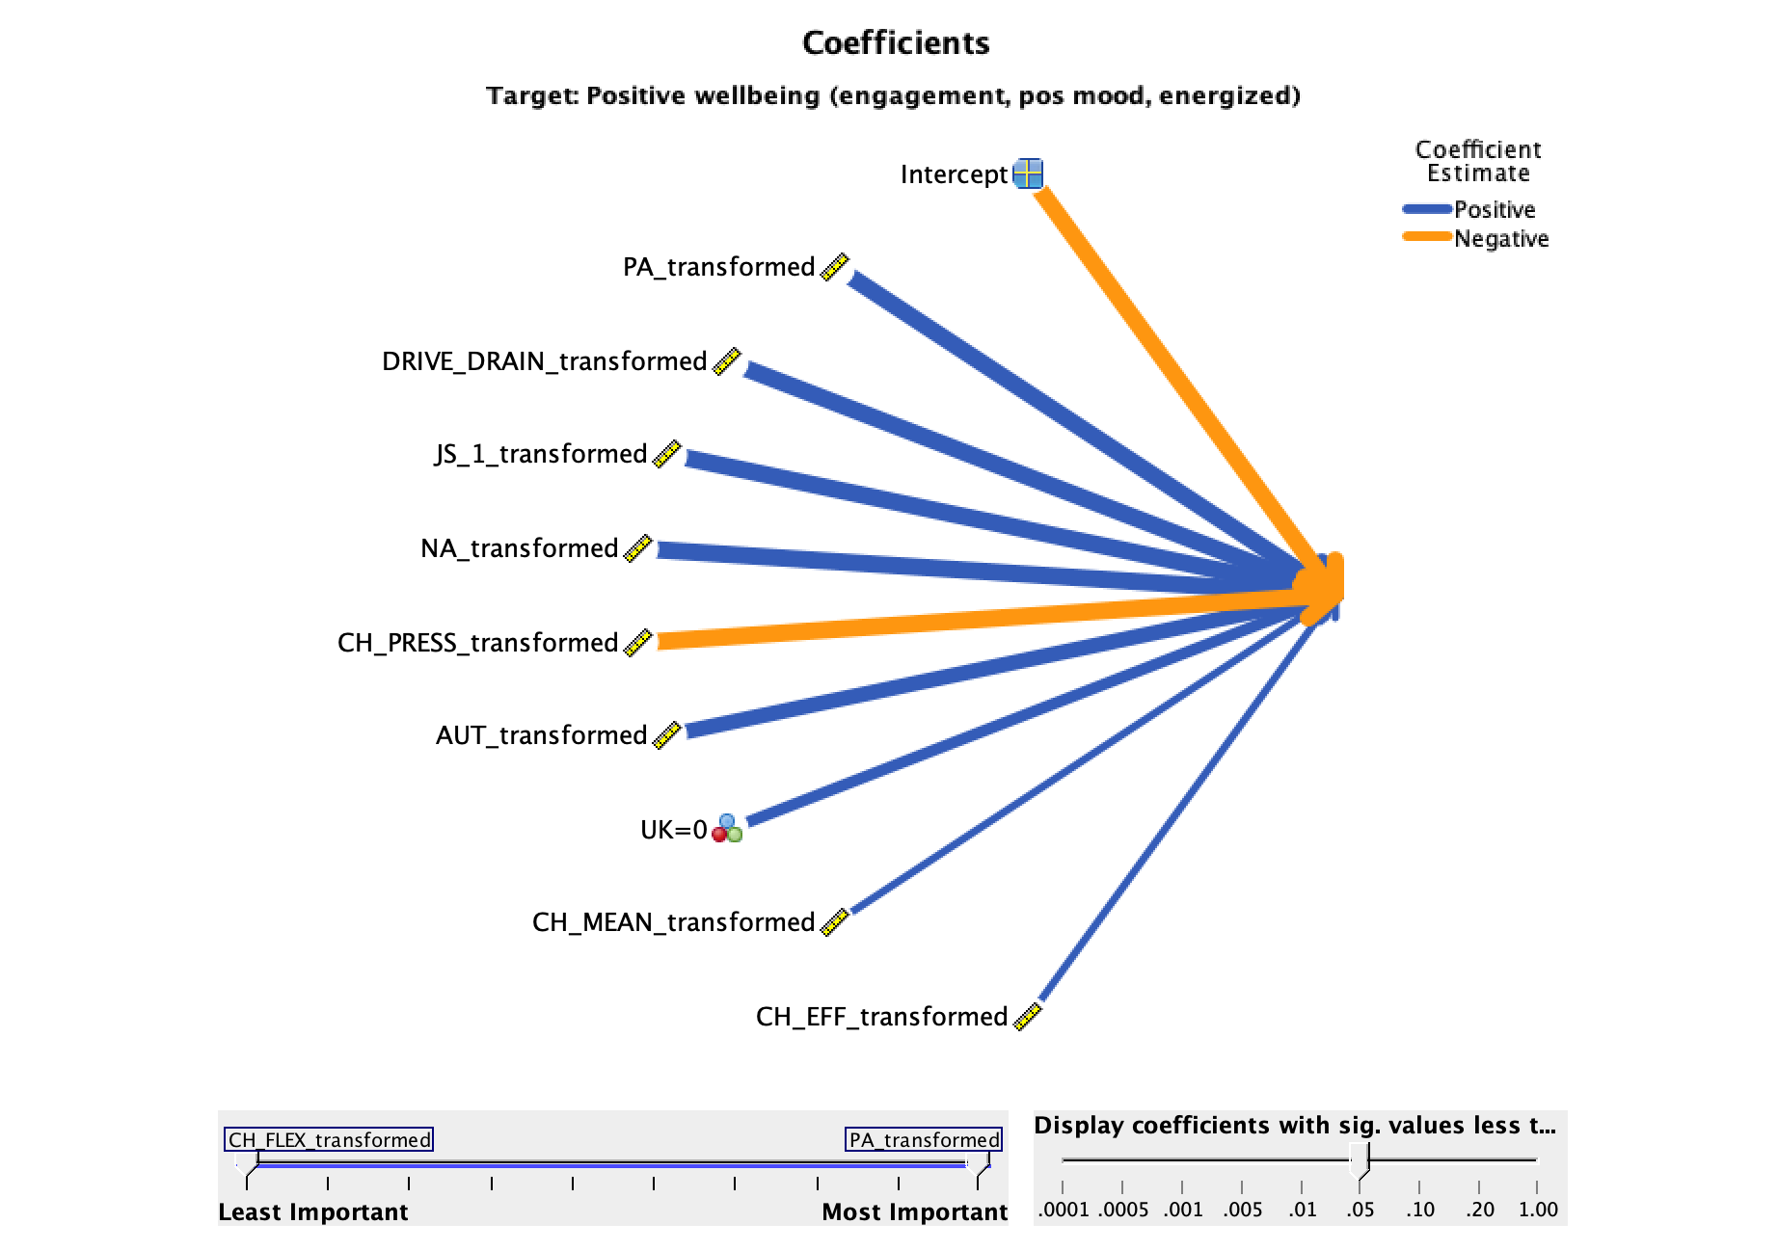
Overall – M1

Slide 10
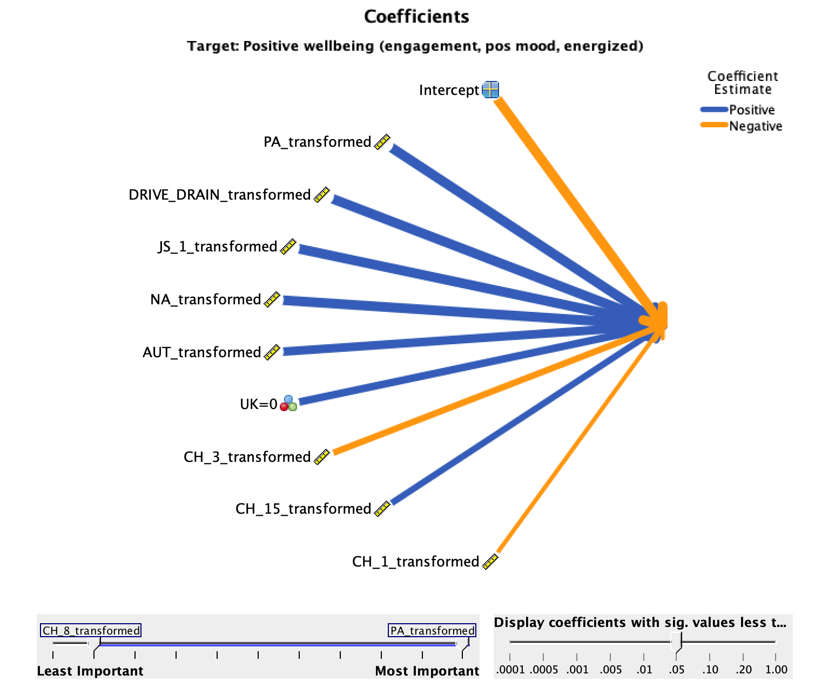
Overall – M2
Workload (PRESS)
Sense of purpose at work (MEAN)
Work-life balance (PRESS)
Notes:
There’s a lot above in here, not sure I have the knowledge or background to interpret wrt Positive SWB

Slide 11
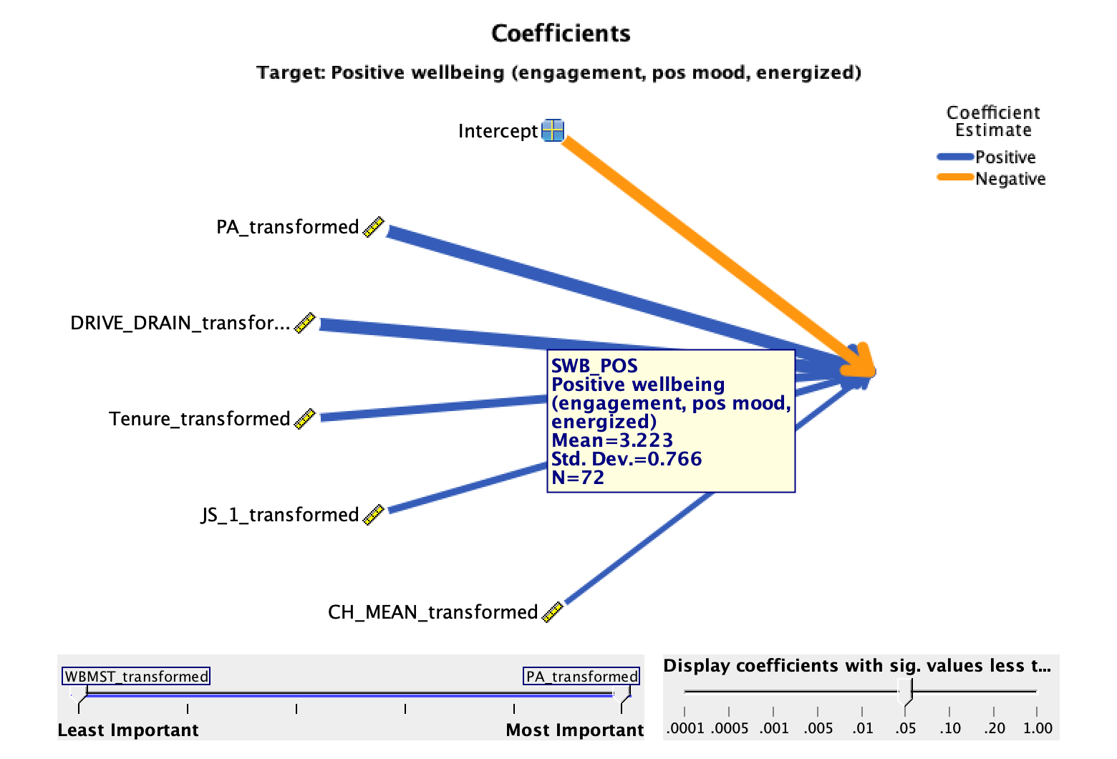
F&E cons - M1
Notes:
Both of these models’ effects are completely dominated by PA (positive mood)

Slide 12
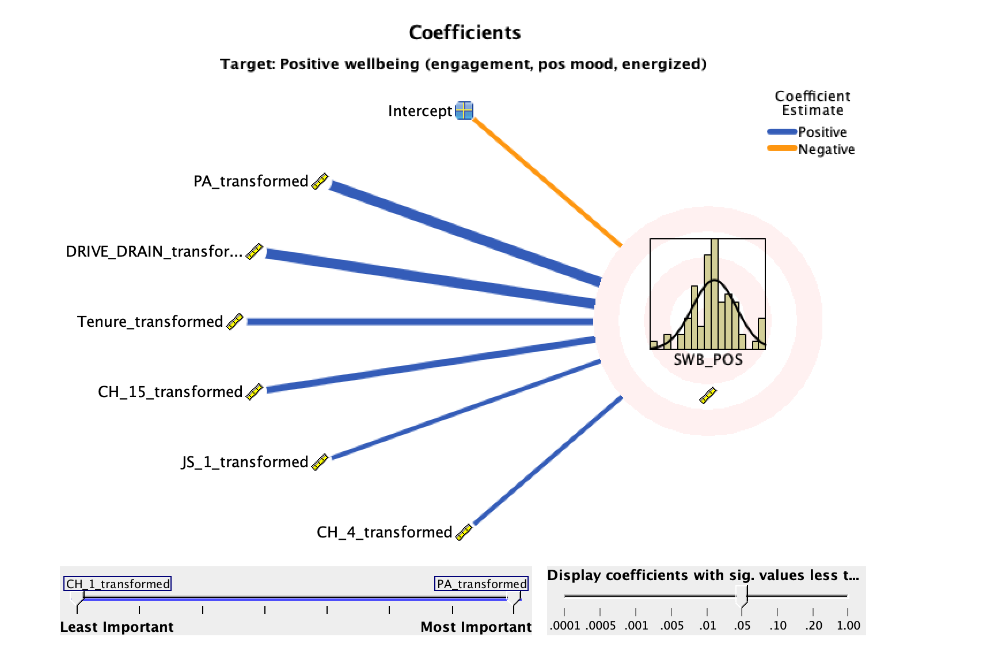
F&E cons - M2
Sense of purpose at work (MEAN)
Pressure to be available (PRESS)
Notes:
Note the significance of one of the two CH_MEAN variables, CH_15 here!
Again, the effects here are dominated by PA again
Again evidence of Job satisfaction playing a role
Tenure shows up here: longer associated with higher positive SWB

